Slide 1
Welcome to Pixello
Created by Emily Mills and Michael Dart

Slide 2
The Idea
A photo sharing application where users can share their photos and interact with other users through liking and commenting on post and private messages
The Purpose
This app exists to meet a gap in the social media space. Whilst other platforms have pivoted their strategy and are amplifying video content. Pixello provides a haven for creators and photography enthusiasts to share and interact with each other and at the same time giving a user the ability to learn and develop their skills.

Slide 3
The Planning
Each task required for the planning phase (Part A of the assignment) was listed on our Trello board. We used the Kanban style board which follows an agile project management methodology. The structure of the board was centered around 4 columns.
These were:
Guidance
This column contained information generic to our planning. It included a quick reference to the board's structure, preferred workflow processes and responses from Educators for our queries.
To-Do All cards started off in this column, each card was moved from this column as needed.
Doing Now Cards were moved as the assigned person was ready to work on the task. We were careful not to have too many cards in this column to ensure we weren't overloaded.
Done Once each task was completed, the card was moved to the Done column

Slide 4
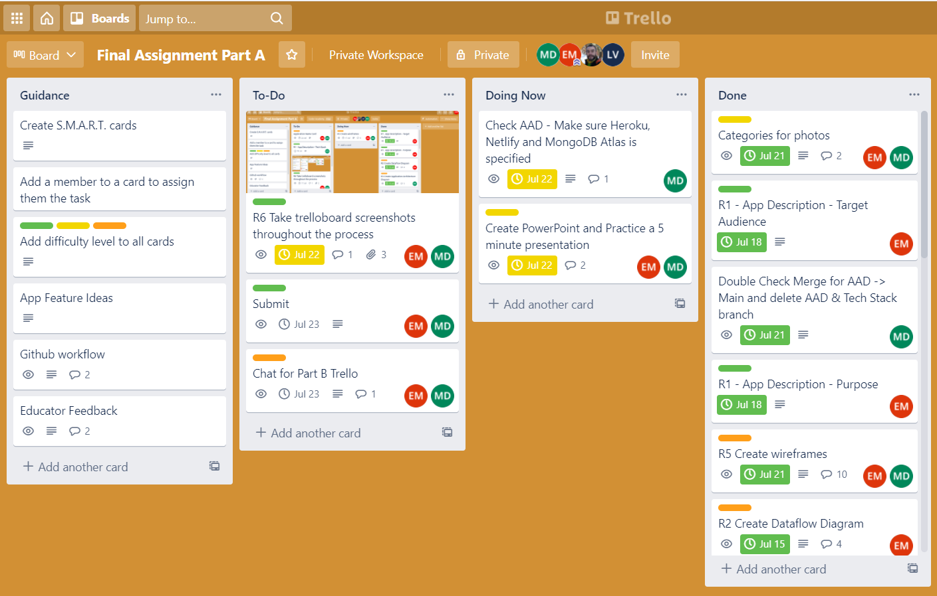
Our Trello Board

Slide 5
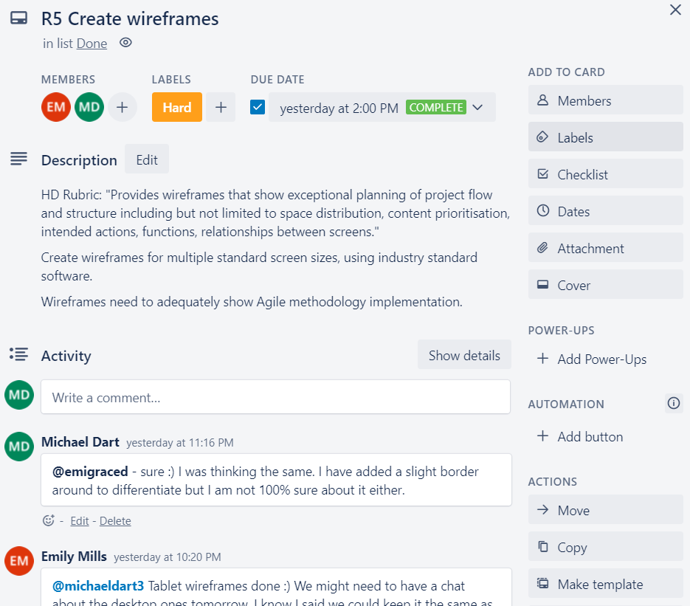
Our Cards
Each card included:
Title and Description
Members The person assigned to the ask
Label
Difficult of task
Due Date For time management

Slide 6
Our Communication
Our communication throughout the planning phase was kept open. Most communication was via Trello where we commented on cards for more "official" feedback, direct messaging for quick input and for the bigger discussions (around planning and wireframes) a call was scheduled in.

Slide 7
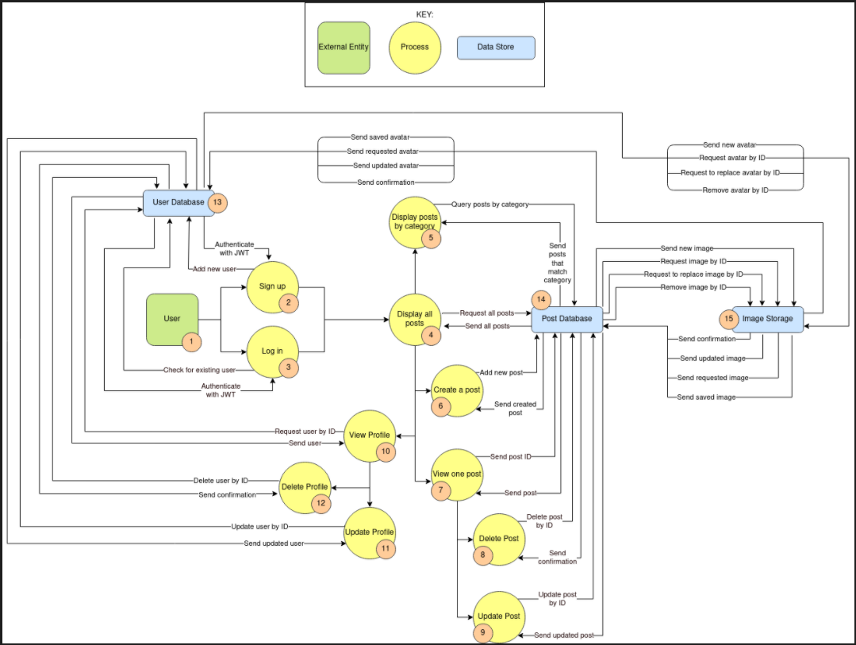
Data Flow Diagram

Slide 8
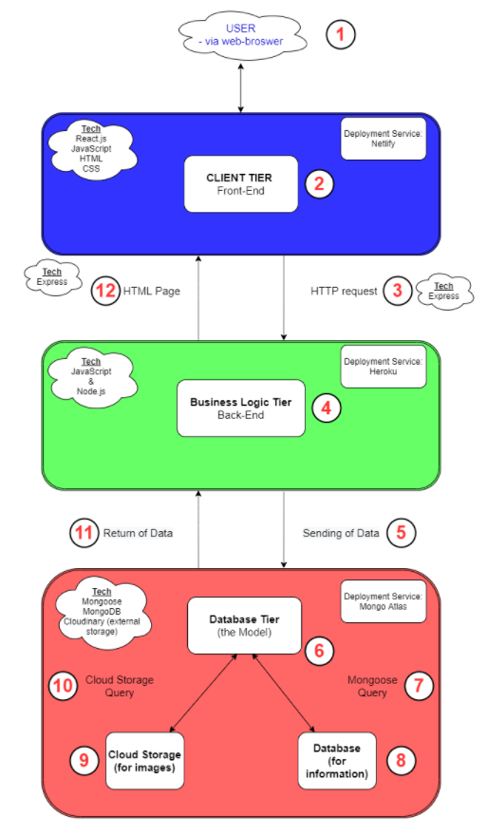
Application Architecture Diagram

Slide 9
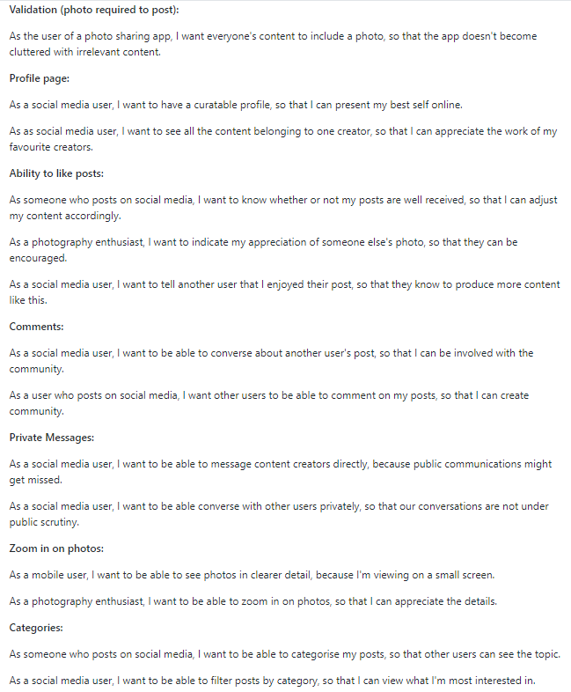
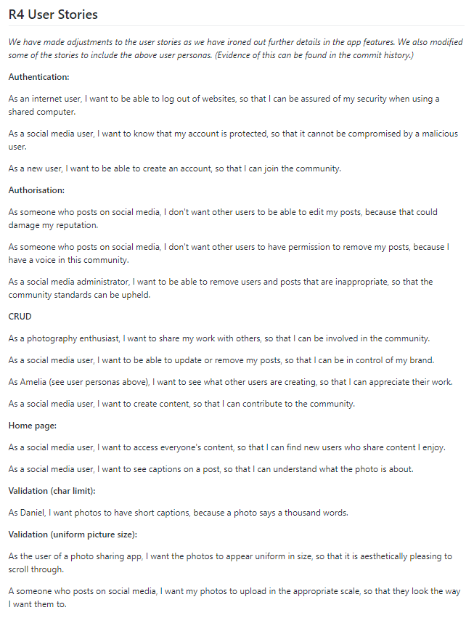
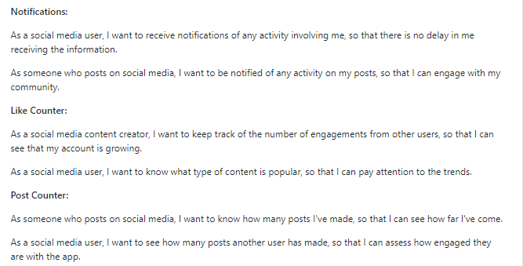
User Stories

